Slide 1
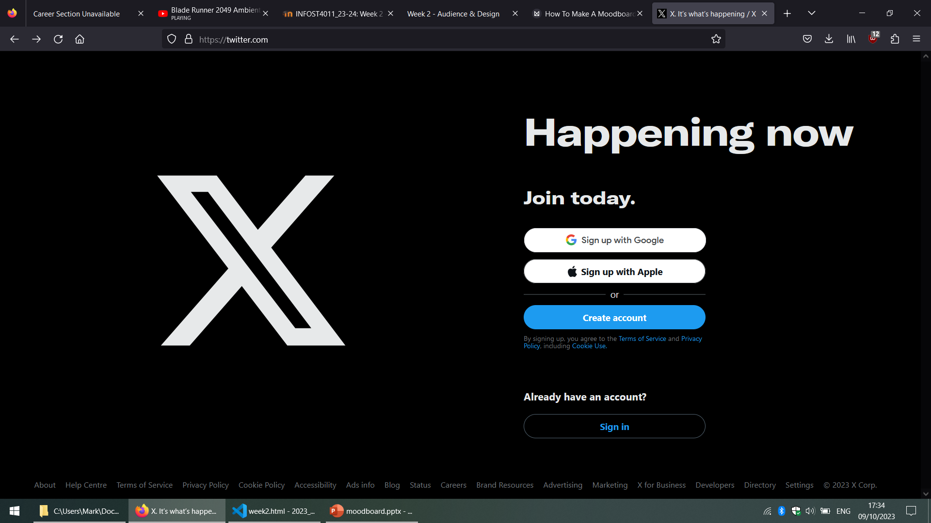


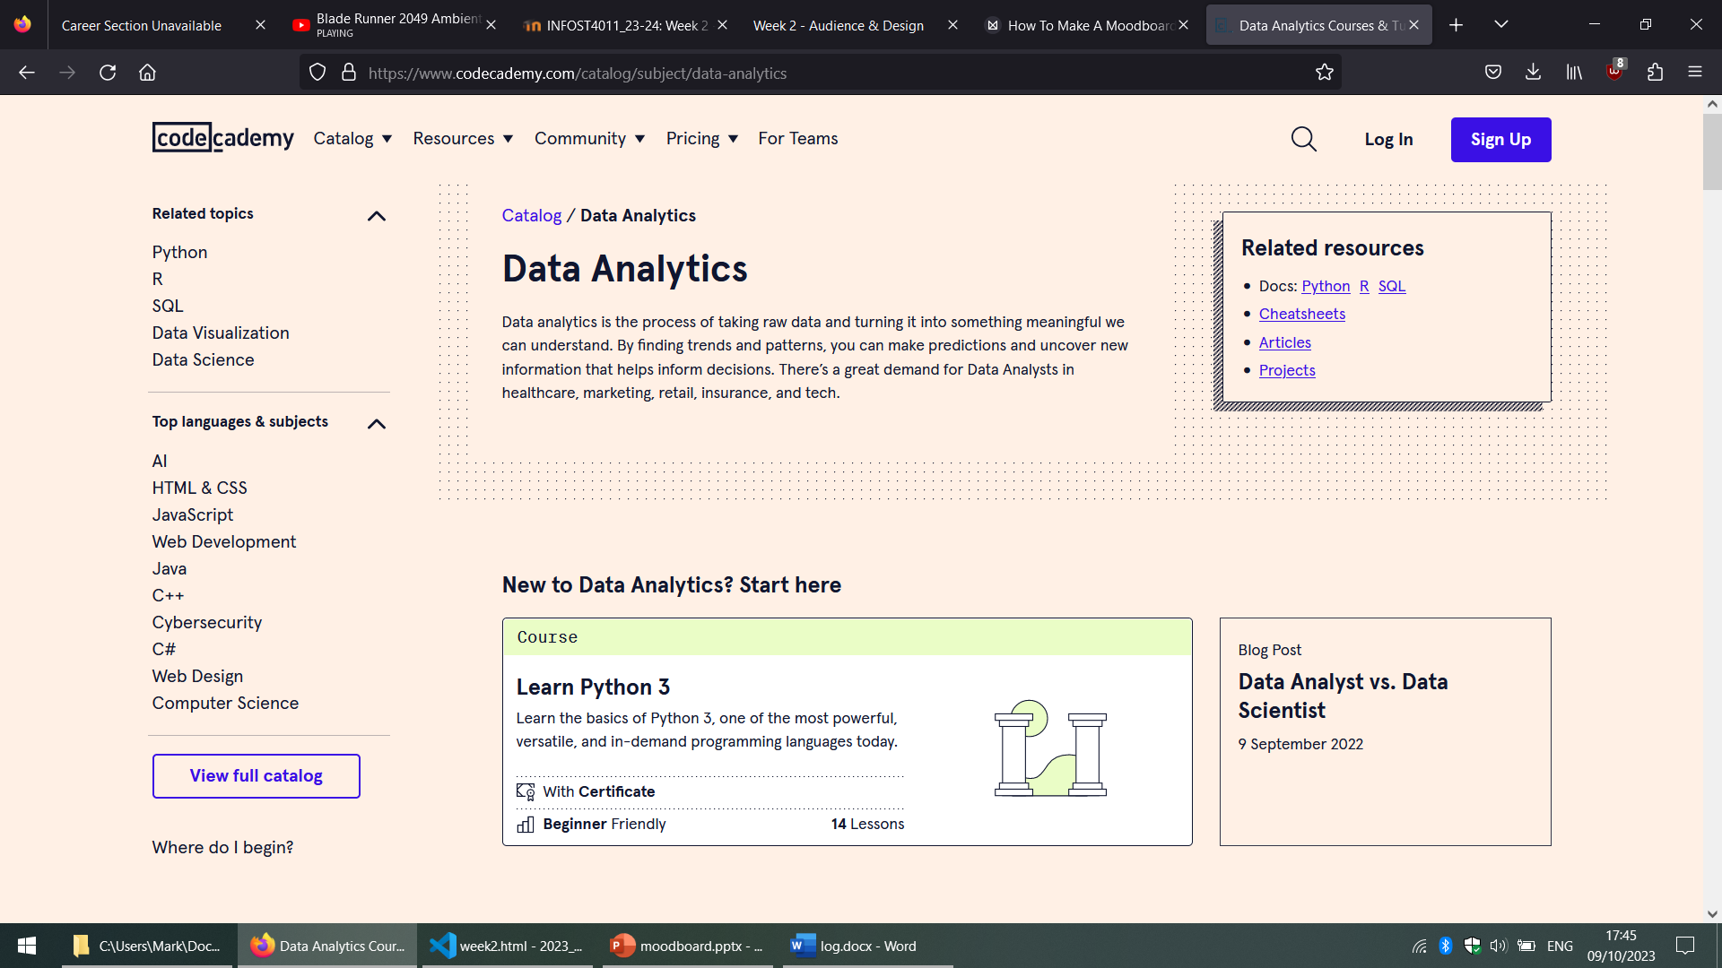
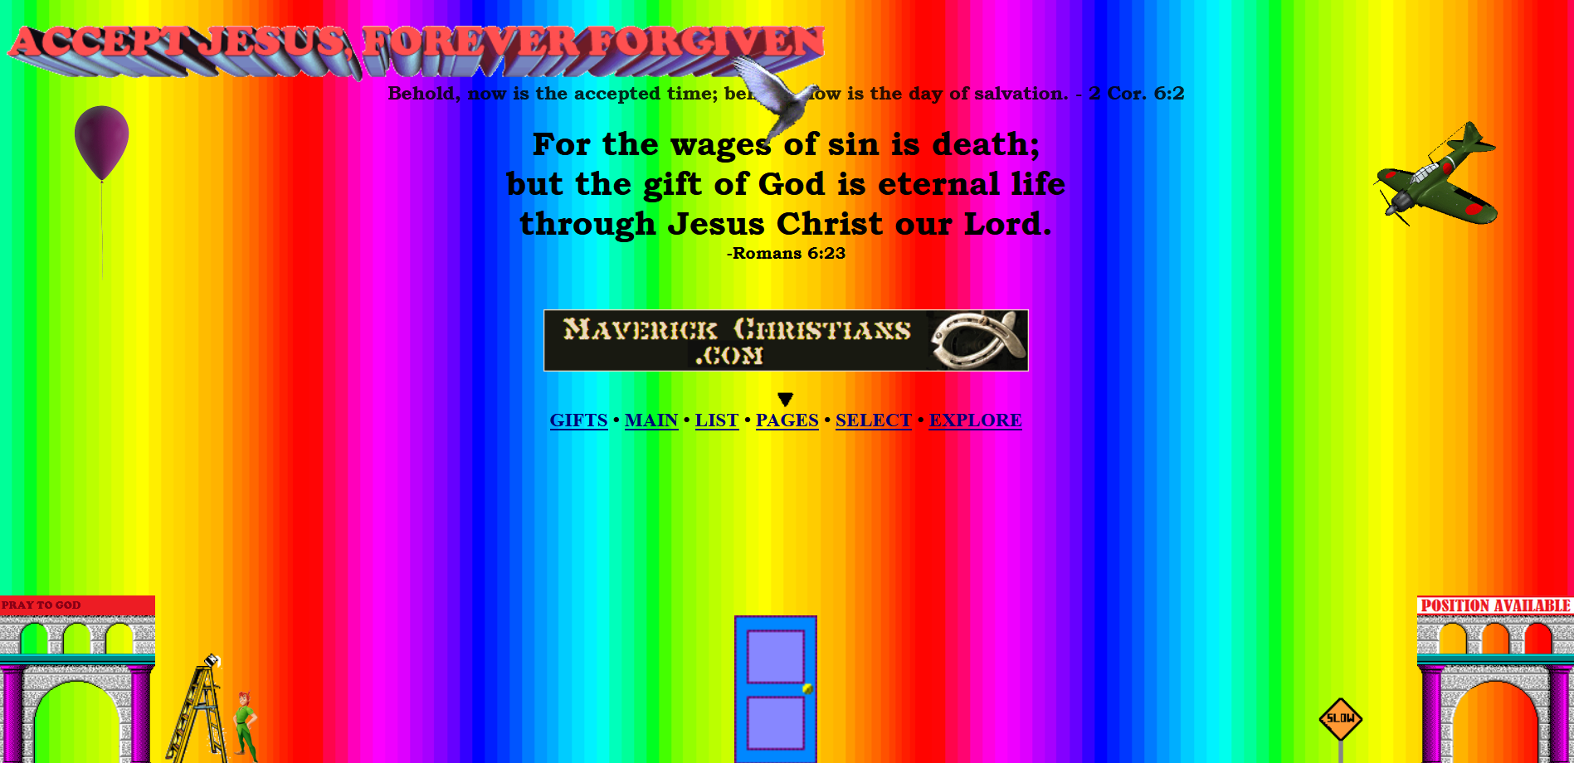
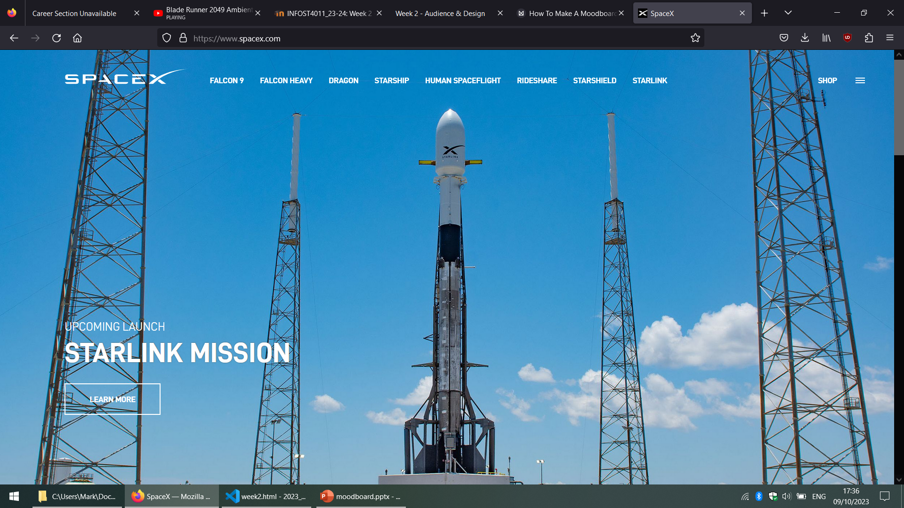
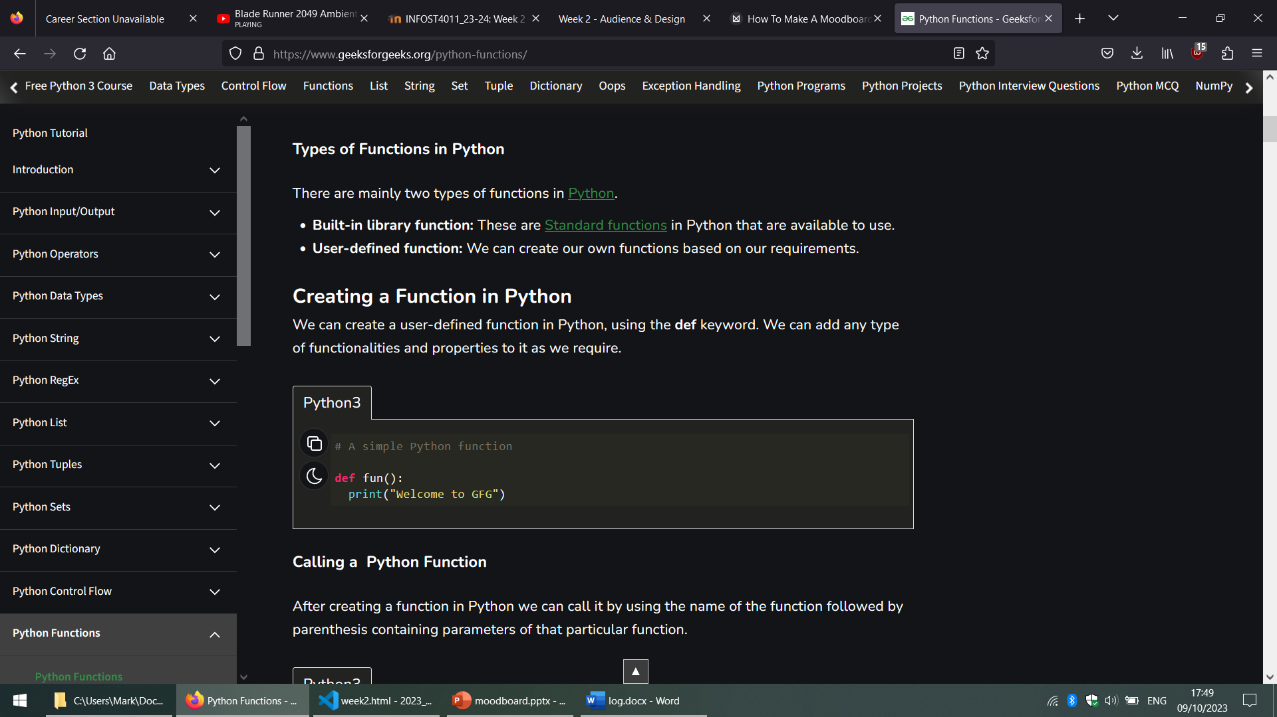
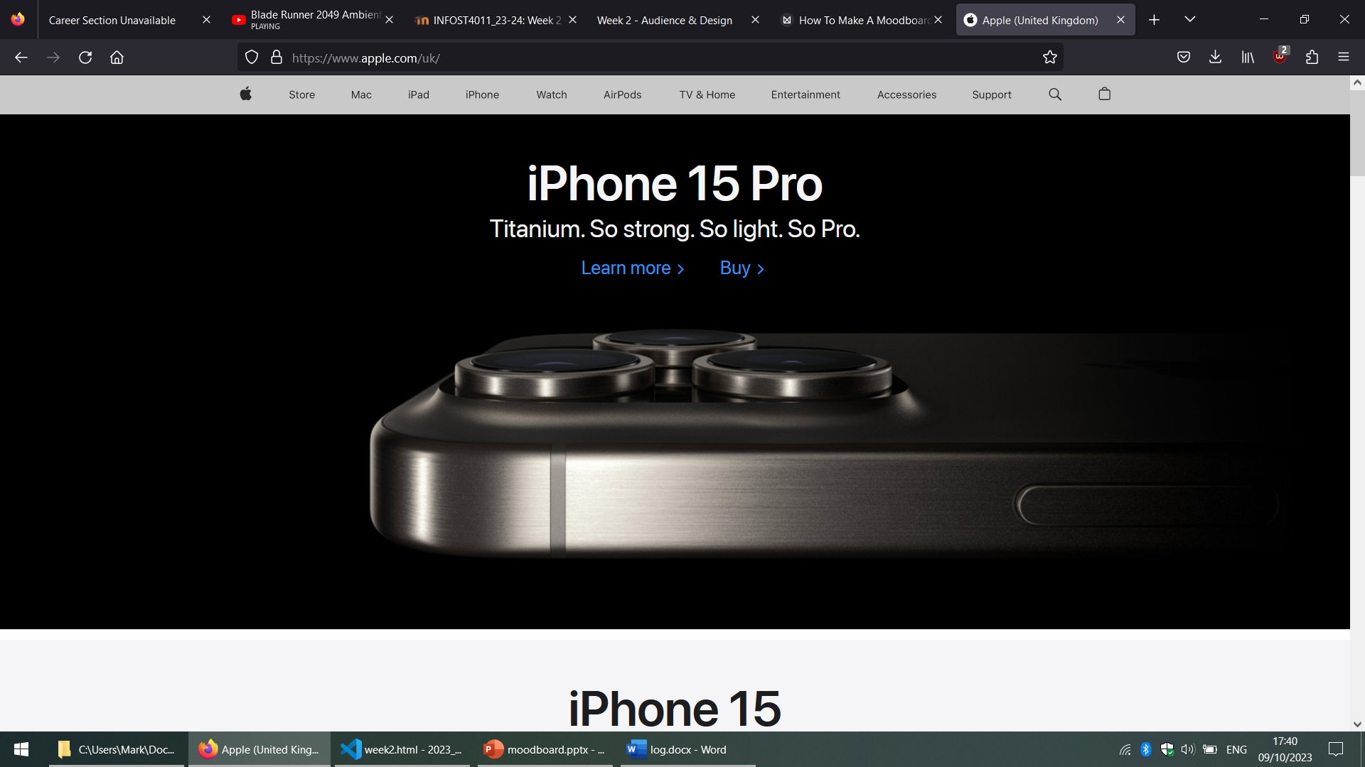
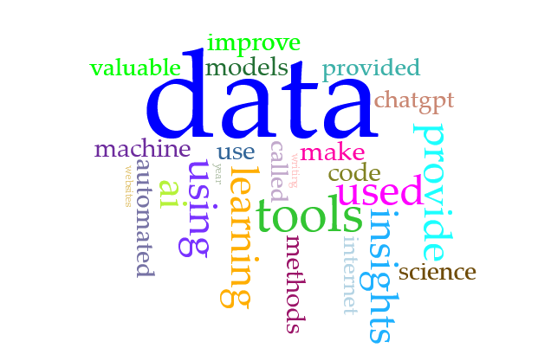
artificial intelligence
black + white, high contrast, space-age feel
drop-down menus
vintage computer console style
avoid bad design, overuse of colours, text as images and low resolution
tech industry
minimal, sleek, large photos used with intent
BIG DATA
use images to improve aesthetic feel for users. to convey values of the project – cutting-edge technology, professionalism, bright future
40 trillion gigabytes per year
Data Storytelling…
INSIGHTS
Data-driven decisions

